Slide 1

BACHELOR OF COMPUTER APPLICATION
MOHAN LAL SUKHADIYA UNIVERSITY,UDAIPUR
PROJECT-CARRENTAL WEBSITE
Submitted By:-
Vidit Mathur
Yogesh Malviya
Project Guide
Mr. Jitesh Kumar

Slide 2
Objectives
Provide an online presence: This makes it easy for customers to find the rent car, view the car, and get information about the cars.
Provide cars information: The car, including hours of operation, location, contact information, and special events or promotions.
Engage with customers: The website should offer ways for customers to engage with the cars, such as through a contact form, email newsletter, or social media links.
Highlight customer reviews: This helps to build trust with potential customers and can encourage them to book the rent car.

Slide 3
Topics
INTRODUCTION
SNAP SHOT
ADVANTAGES
CONCLUSION
REFERENCES

Slide 4
INTRODUCTION
The “Car Rental Website” has been developed to override the problem rent a car and Get a rented car sitting at home manual system. This website supported in almost every browser. This website designed for make car rent need of the provide rented car to user in a smooth and effective manner.
This website is reduced as much as possible to avoid errors while entering the data. No format knowledge is needed for the user to use this website. Thus by this all it proves it is user-friendly. Car rental website, as described above, can lead to error free, reliable and fast management system. It can assist the user to concentrate on their other activities rather to concentrate on the record keeping. Thus it will help user to rent car in better utilization of resources.

Slide 5
SNAP SHOTS

Slide 6

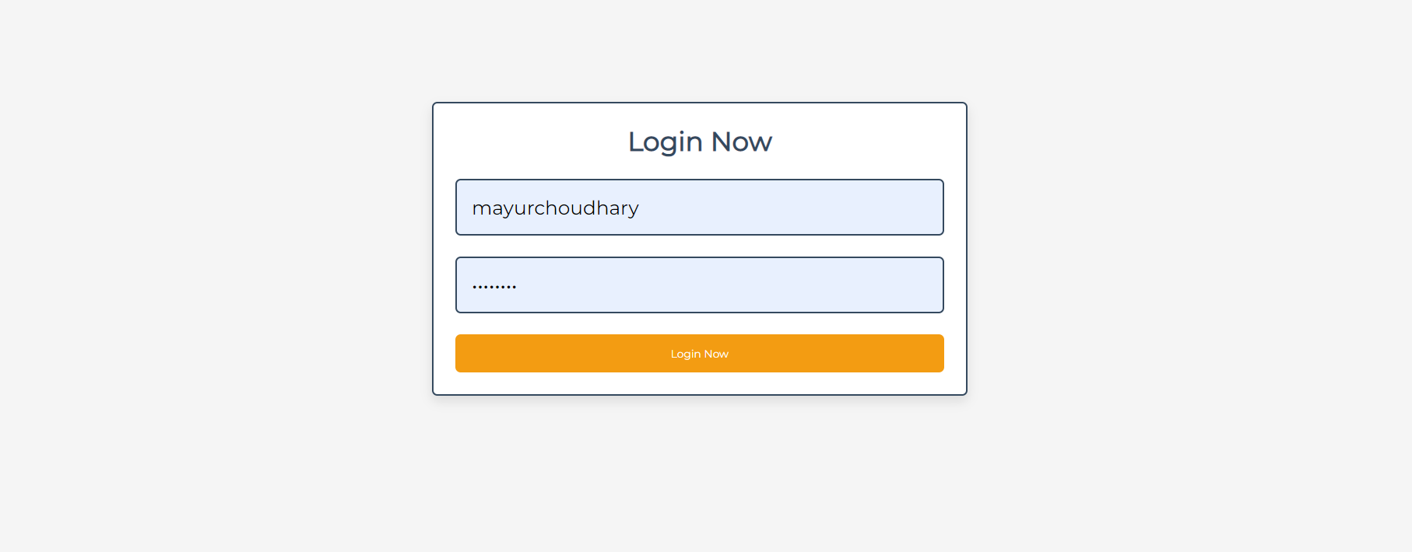

ADMIN-PANNEL
1.LOGIN-FORM
This helps to Admin to Login the Admin Pannel

Slide 7
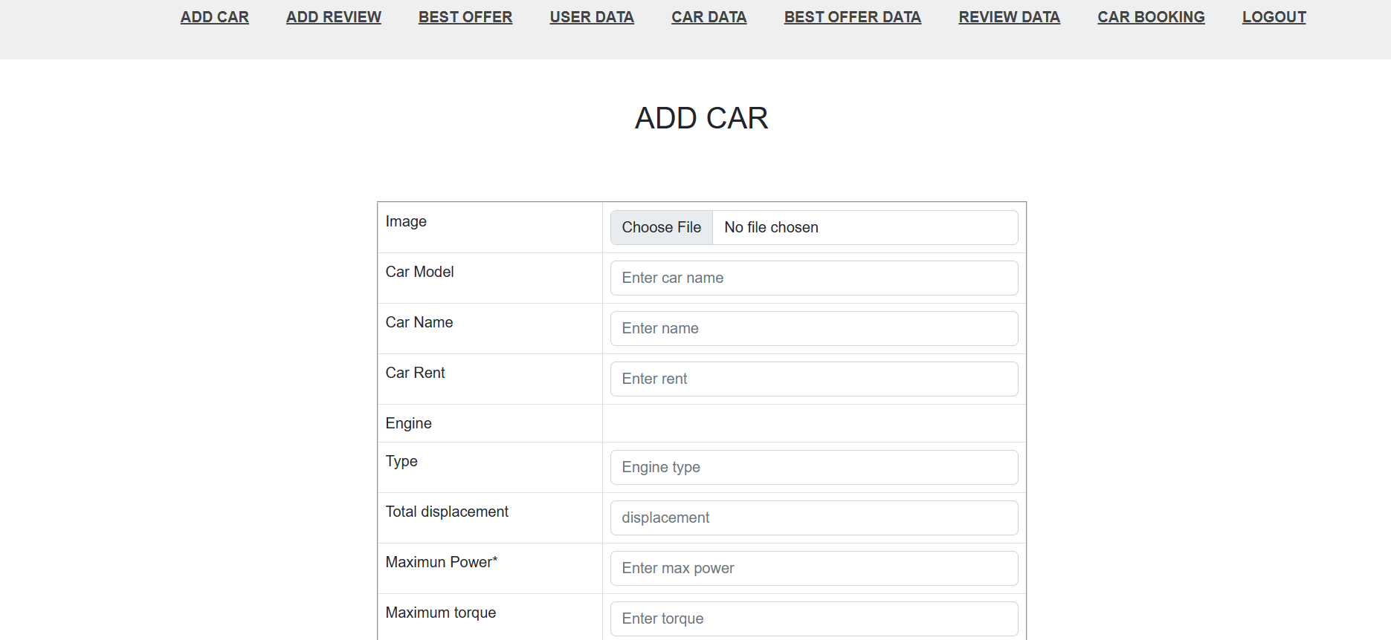
3.Add Car

Slide 8
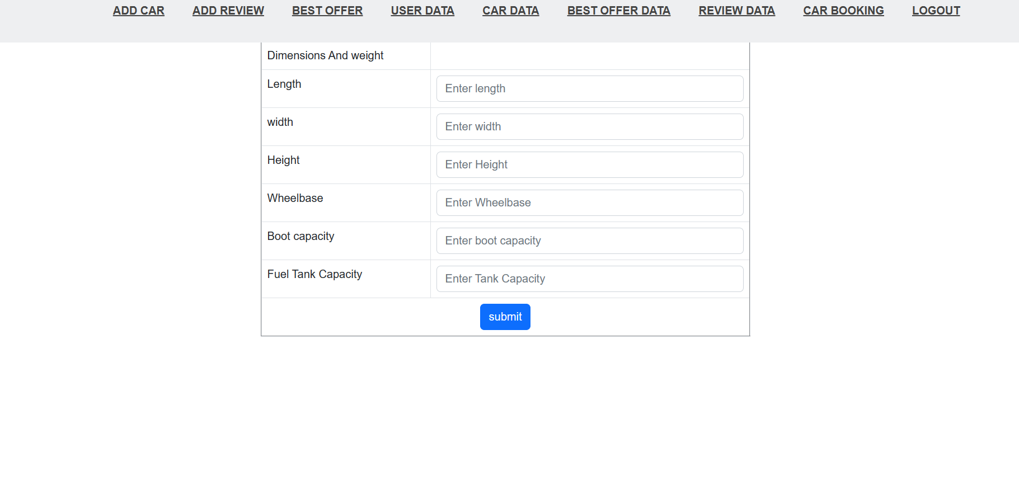
This help to Add cars

Slide 9
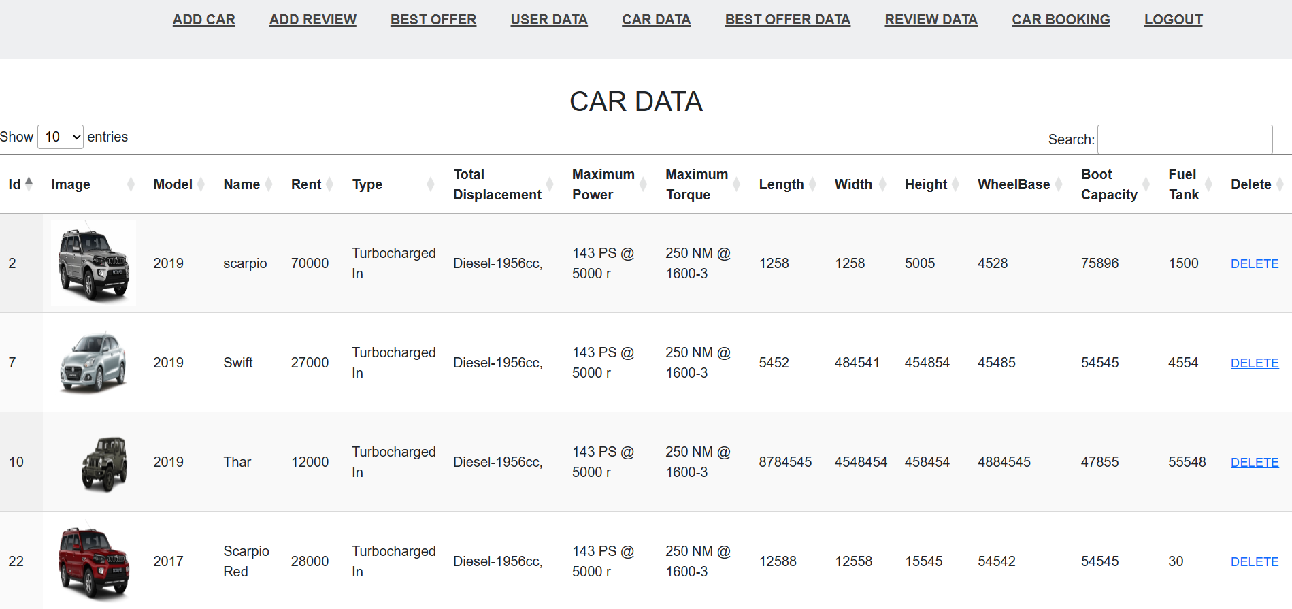
4.Car Data
Uploaded car data is here admin can delete ,edit the car data

Slide 10
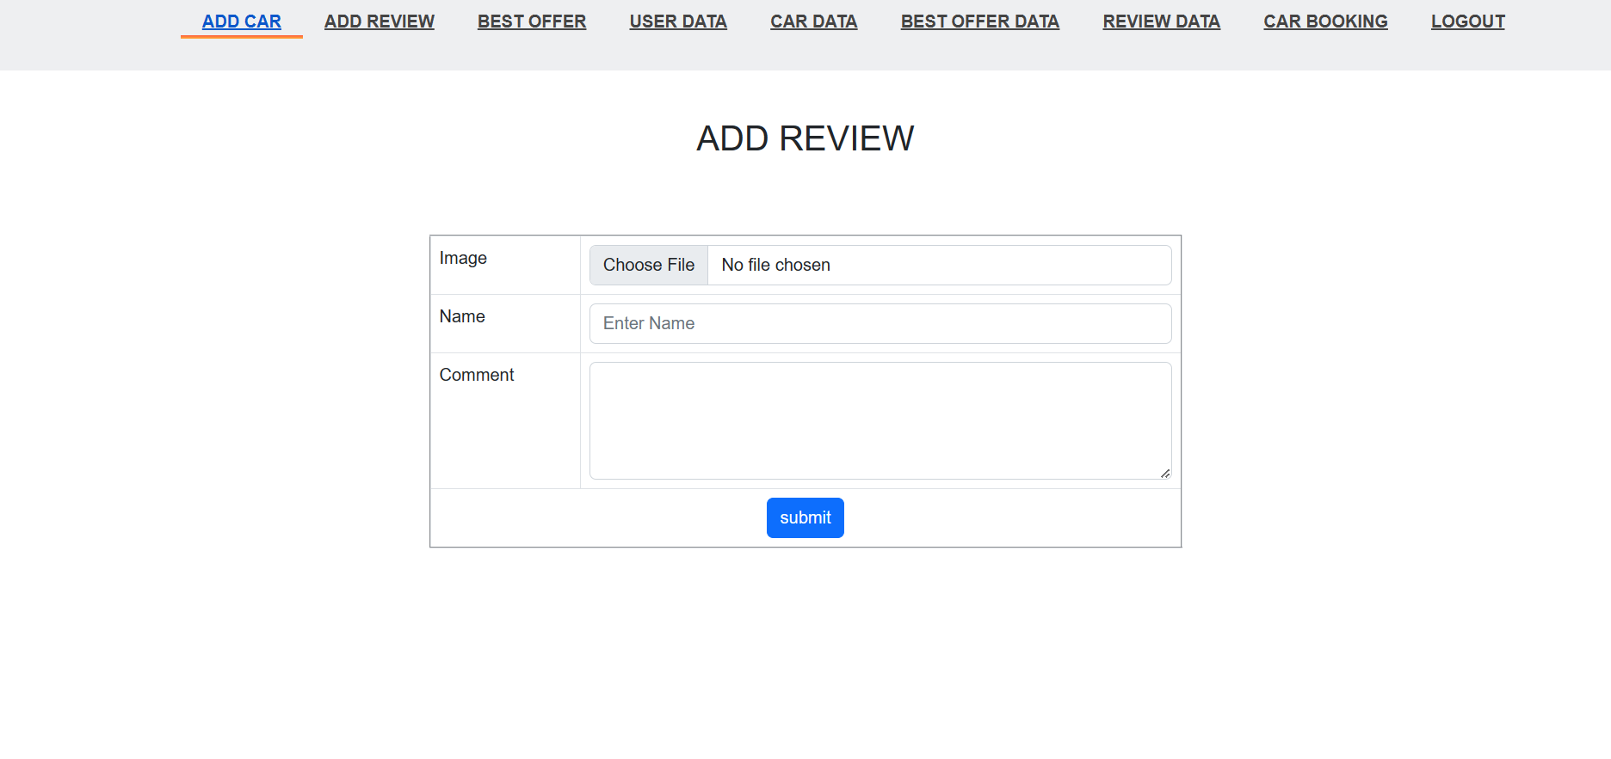
5.ORDER-STATUS
Here we can see the order status and other information about the orders.

Slide 11
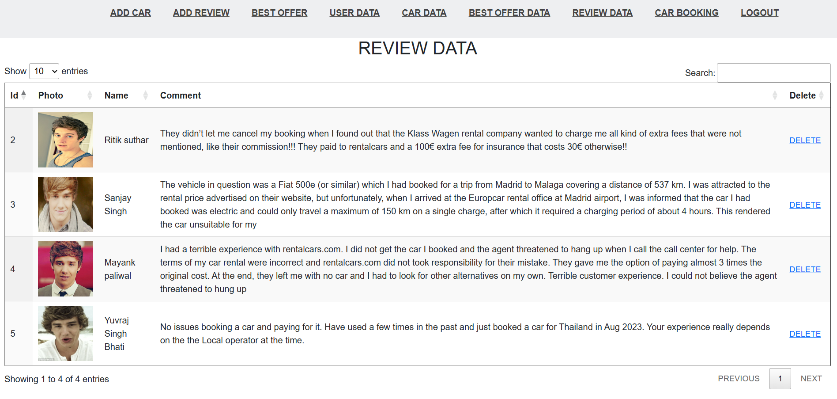
6. REVIEW DATA
Show review data.

Slide 12
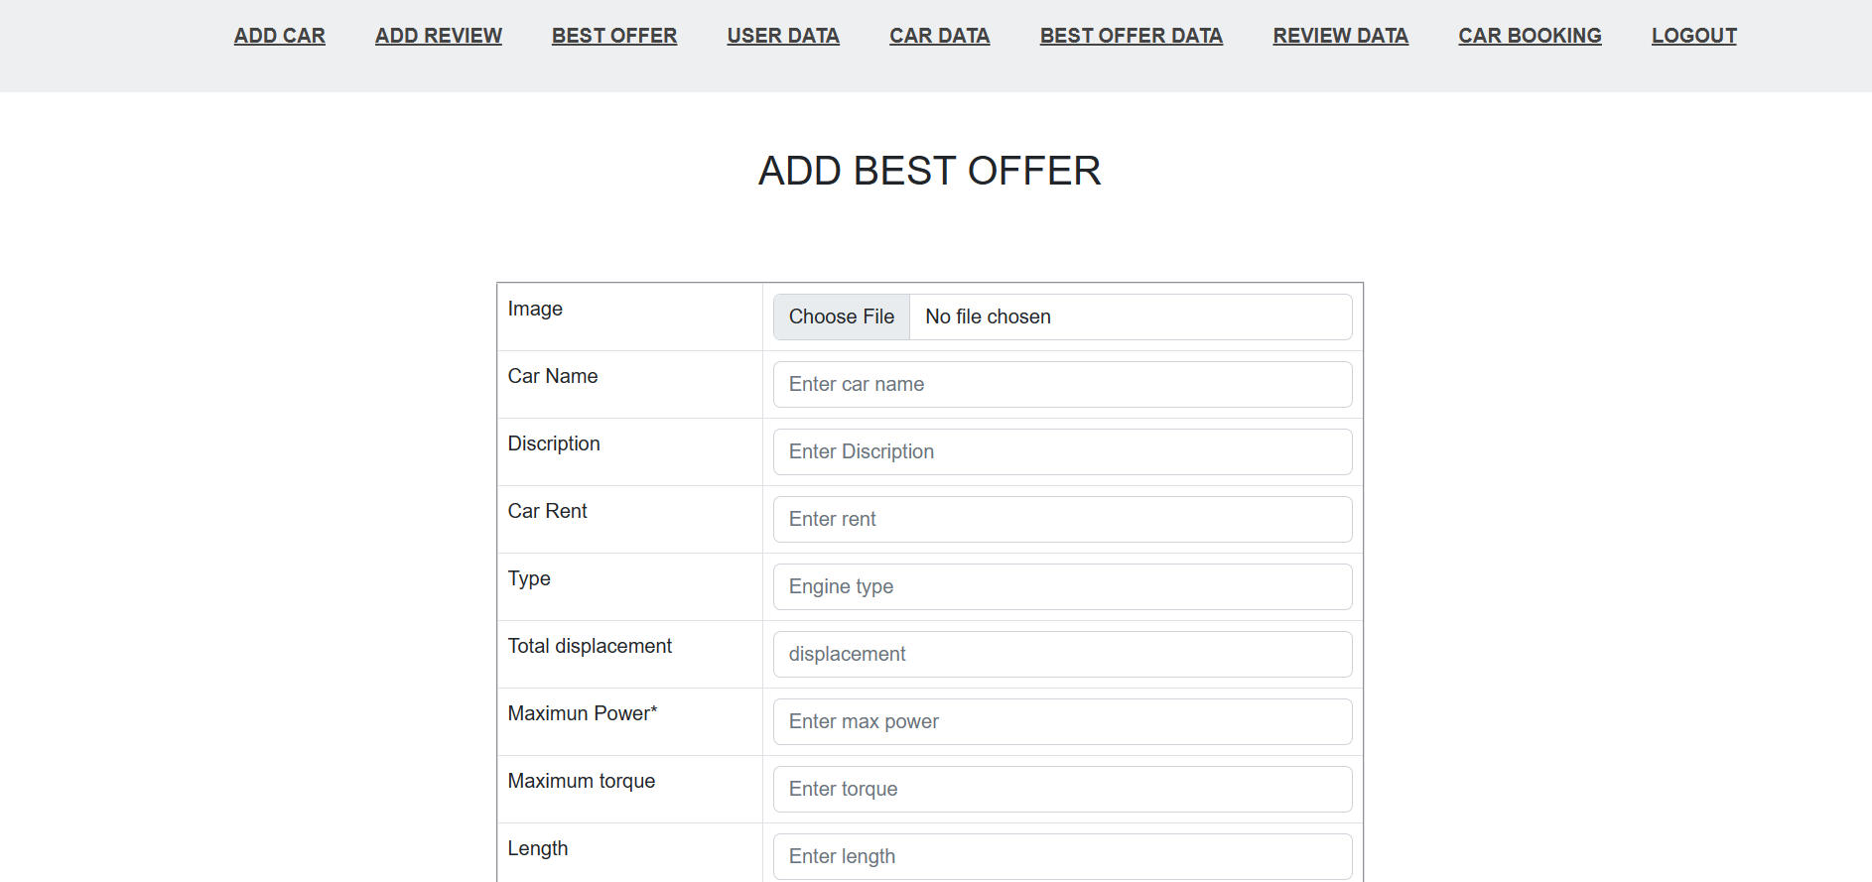
7. BEST OFFER DATA

Slide 13
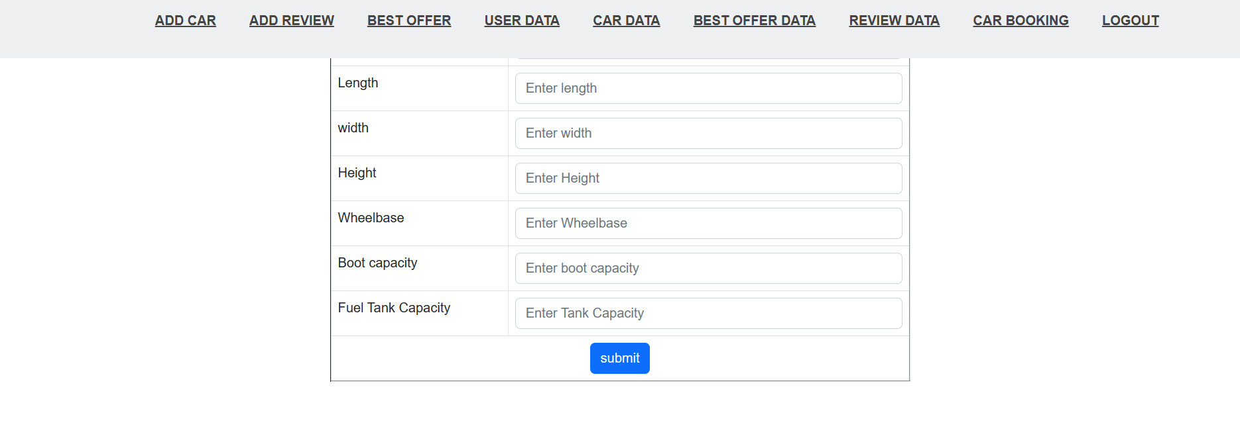
Add Best Offer Data.

Slide 14
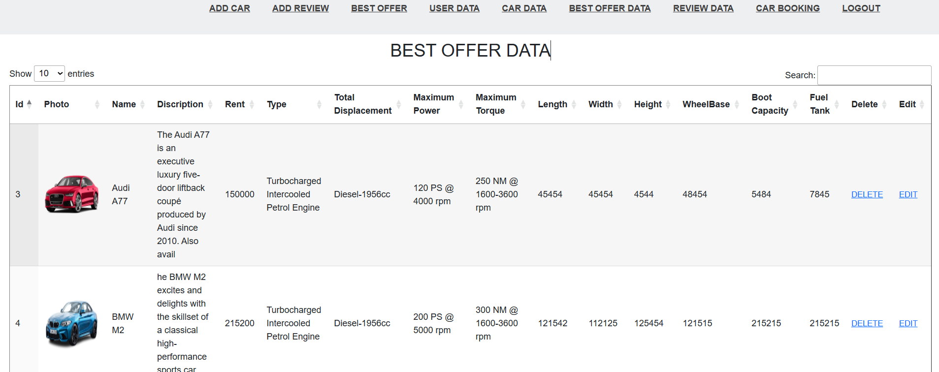
7. BEST OFFER DATA
Admin can edit and delete the best offer data

Slide 15
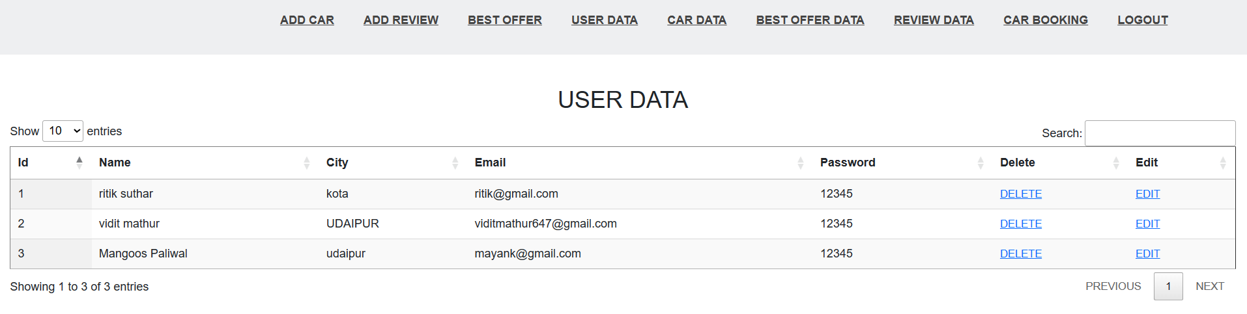
8. USER DATA
User data Admin can delete and modify the data

Slide 16
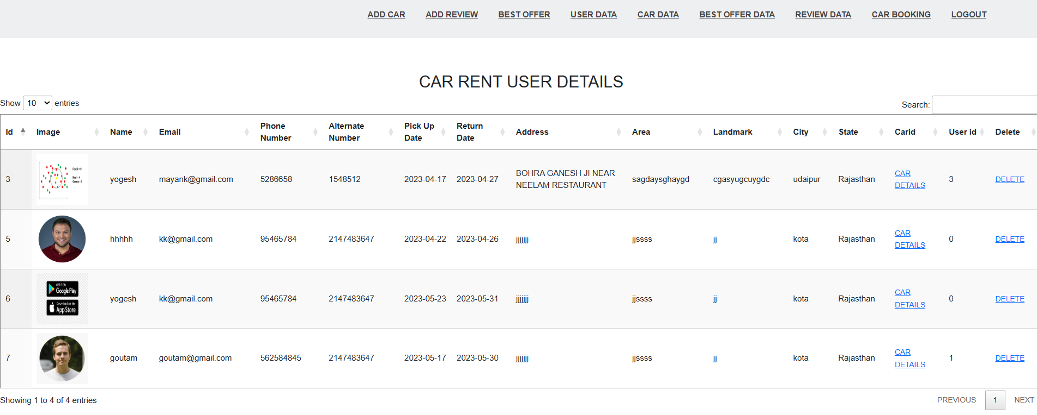
9. CAR BOOKING
This help to show car booking data.

Slide 17
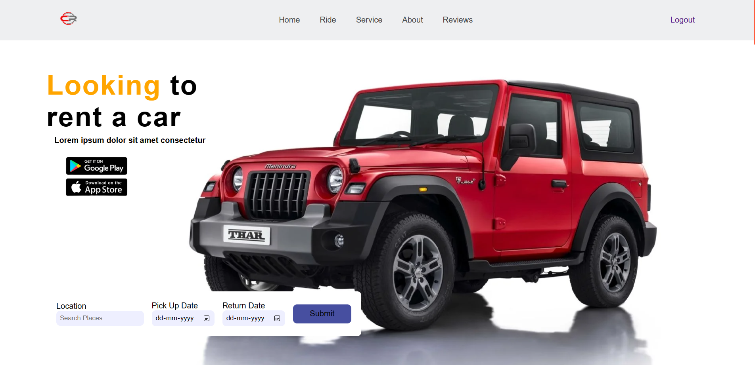
10. HOME PAGE
Home Page of website

Slide 18
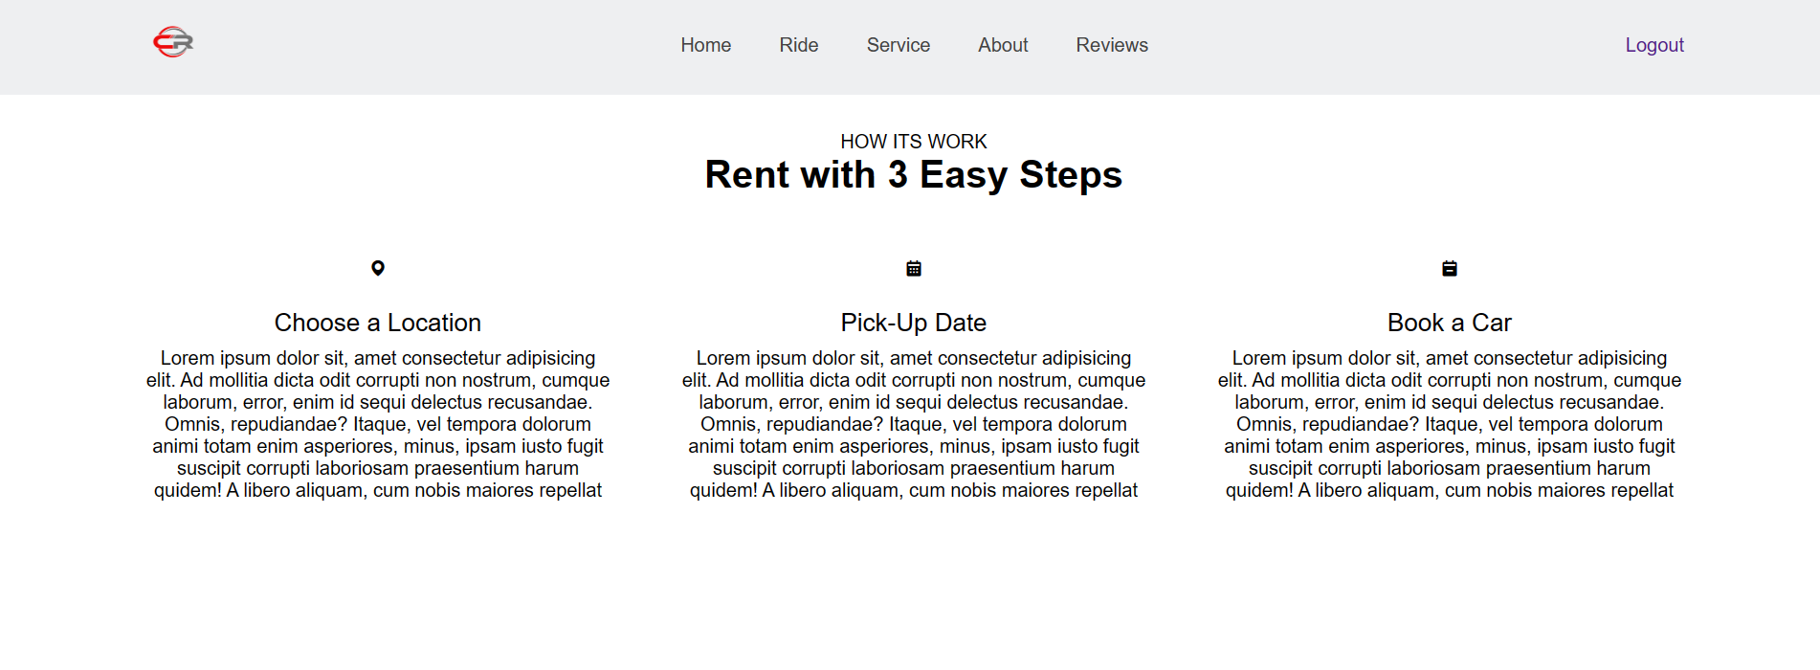
11. RIDE
Ride section of Website

Slide 19
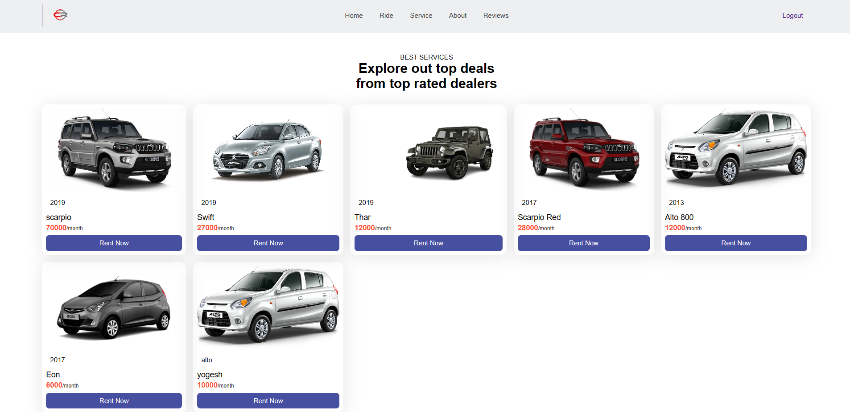
12. SERVICES
Rent car service here

Slide 20
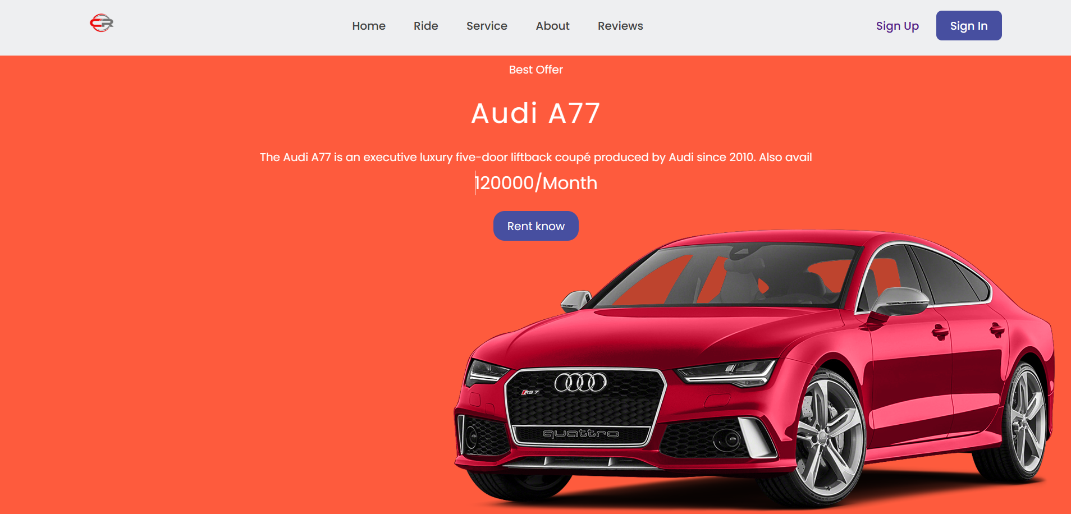
13. Best Offers
Best rent car offers

Slide 21
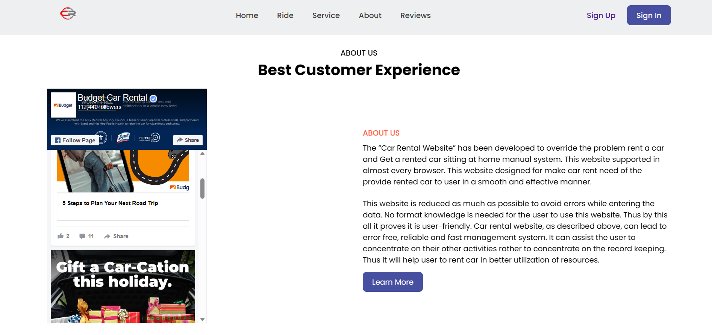
14. ABOUT
About the car rental website

Slide 22
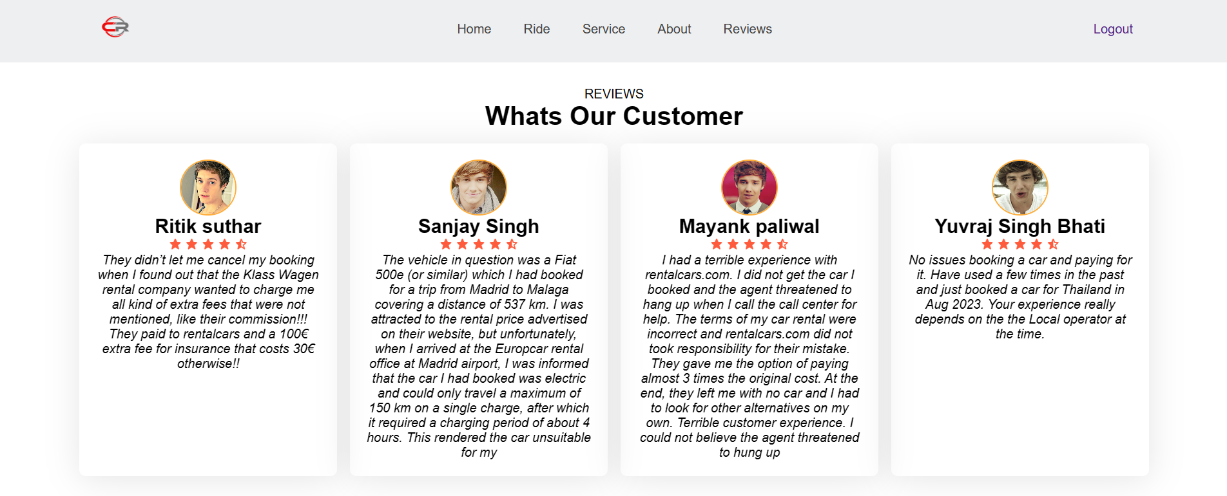
15. REVIEWS
Reviews of car rental website

Slide 23
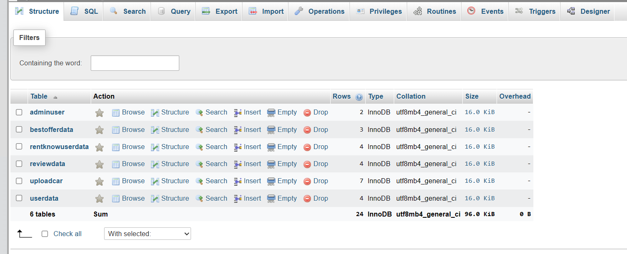
16. Database

Slide 24
Advantages :
Online Booking Made Simple and Instant
Your potential customers will be able to book a vehicle from wherever they are, at any time, thanks to the car rental system development. As a result, this convenience will improve your customers’ experience, and as a result, increase your revenue.
2. Time saving
If we prefer to use outside showroom for the rent car then we will find it time consuming process because for that we need to go to the market and visit to 2-3 showroom then rent a rented car but in online platform we can visit N numbers of shops in just one click and without traveling. We can rent a car anywhere like at home, at workplace etc.
3. Provide More Convenience
If the online car rental business is expanded to multiple locations, having the convenience of an online reservation system for a car rental business will help you manage all your business operations efficiently.
4. Round the Clock Availability
One of the greatest benefits of an online car rental booking system is its availability 24 hours a day, 7 days a week.q

Slide 25
CONCLUSION
The solution was to provide car Rental with an user-friendly web application that would allow for customers to access and use on a wide range of devices: desktops, laptops, mobile devices, tablets.
The website is designed to stay up to date by giving administrators the ability to change/add/remove any featured vehicles on the site.
The website will verify and store any information the user may input when making a rental purchase request.
This will appear in real time onto the software used by the employees.
This software provides an easy-to-use interface to allow for simple access to rental requests and customer information.

Slide 26
REFERENCES
WEBSITE
www.getbootstrap.com
www.dynamicdrive.com
www.mysql.com
www.php.net
BOOKS
PHP: The Complete Reference
Head First PHP & MySQL
PHP Solution
Learning PHP, MySQL & JavaScript

